Slide 1
NGBoost: Natural Gradient Boosting for Probabilistic Prediction
Tony Duan*, Anand Avati*, Daisy Ding, Khanh K. Thai,
Sanjay Basu, Andrew Ng, Alejandro Schuler
https://stanfordmlgroup.github.io/projects/ngboost/

Slide 2
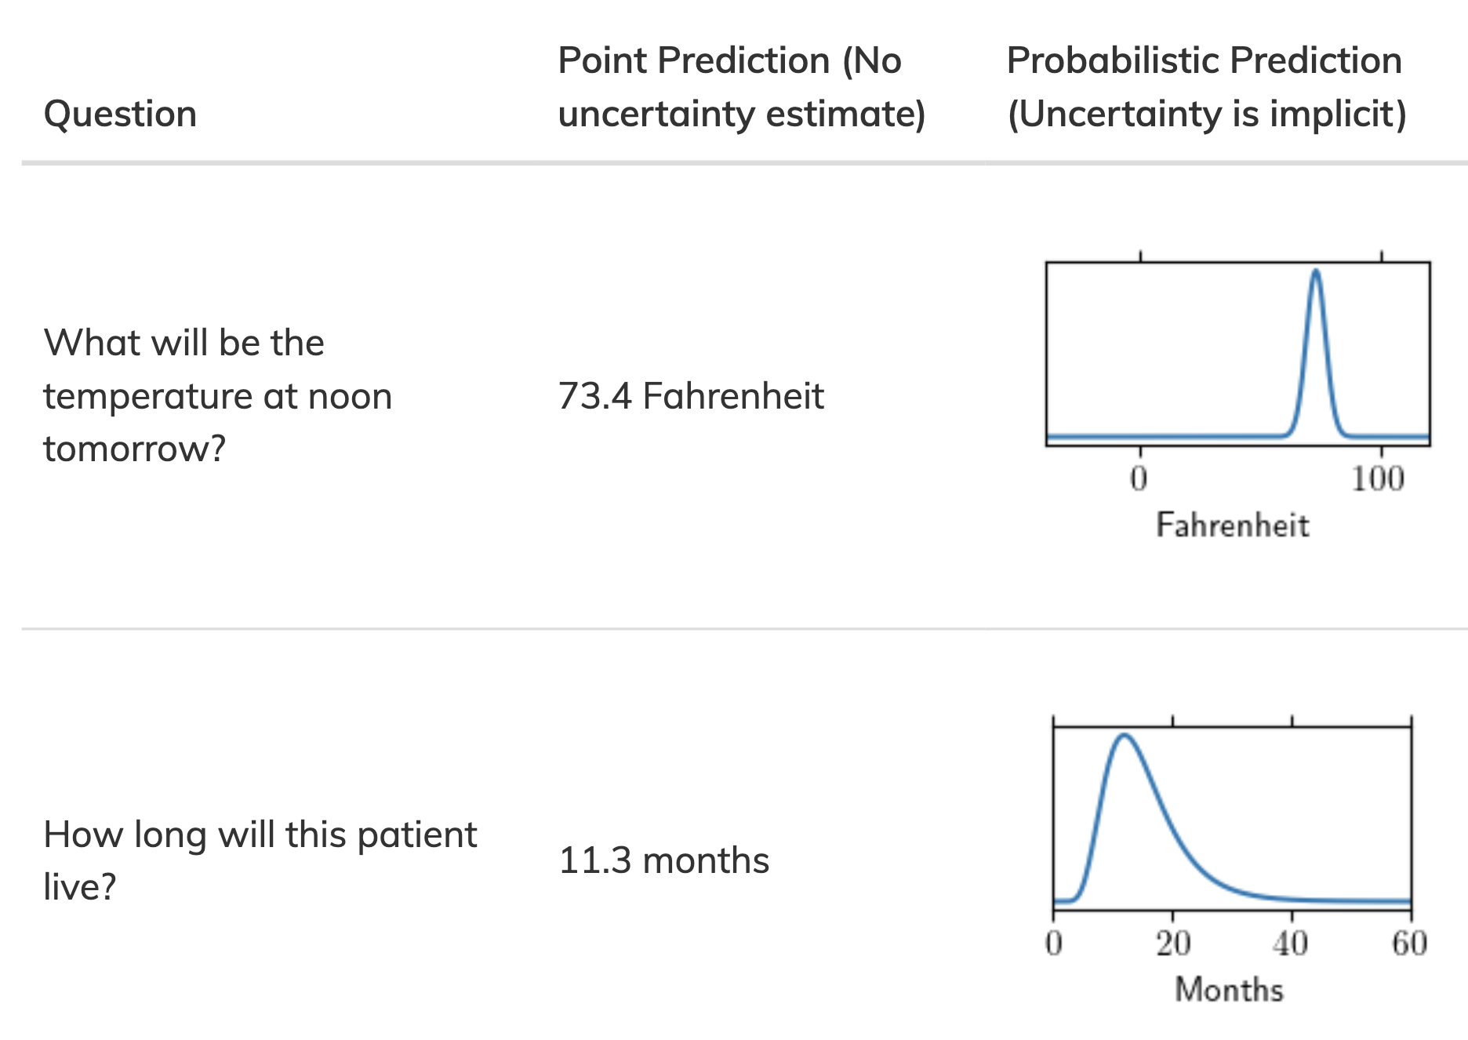
Probabilistic Prediction

Slide 3
Probabilistic Prediction

Slide 4
Probabilistic Prediction
X=x
E[Y|X=x]
P(Y|X=x)

Slide 5
Probabilistic Prediction
X=x
E[Y|X=x]
P(Y|X=x)

Slide 6
Probabilistic prediction is already standard for classification
Regression
Classification
Will this patient get sepsis during this hospitalization?
P(no) = 0.87
P(yes) = 0.13
no

Slide 7
Probabilistic prediction for regression

Slide 8
Existing probabilistic methods for regression are slow, inflexible, don’t scale, and hard to use
Post-hoc variance
Assumes homoscedasticity
GAMLSS
Linear mean model
Bayesian methods
MCMC needed for complex models
Bayesian deep learning
Requires expertise

Slide 9
Outline of our approach
Pick a scoring rule to grade our estimate of P(Y|X=x)
Assume that P(Y|X=x) has some parametric form
Fit the parameters θ(x) as a function of x using gradient boosting
Use the natural gradient to correct the training dynamics of this approach

Slide 10
Pick a scoring rule to compare probabilistic predictions to ground truth
Point Prediction | Loss Function
Probabilistic Prediction | Scoring Rule
Example scoring rule: negative log-likelihood

Slide 11
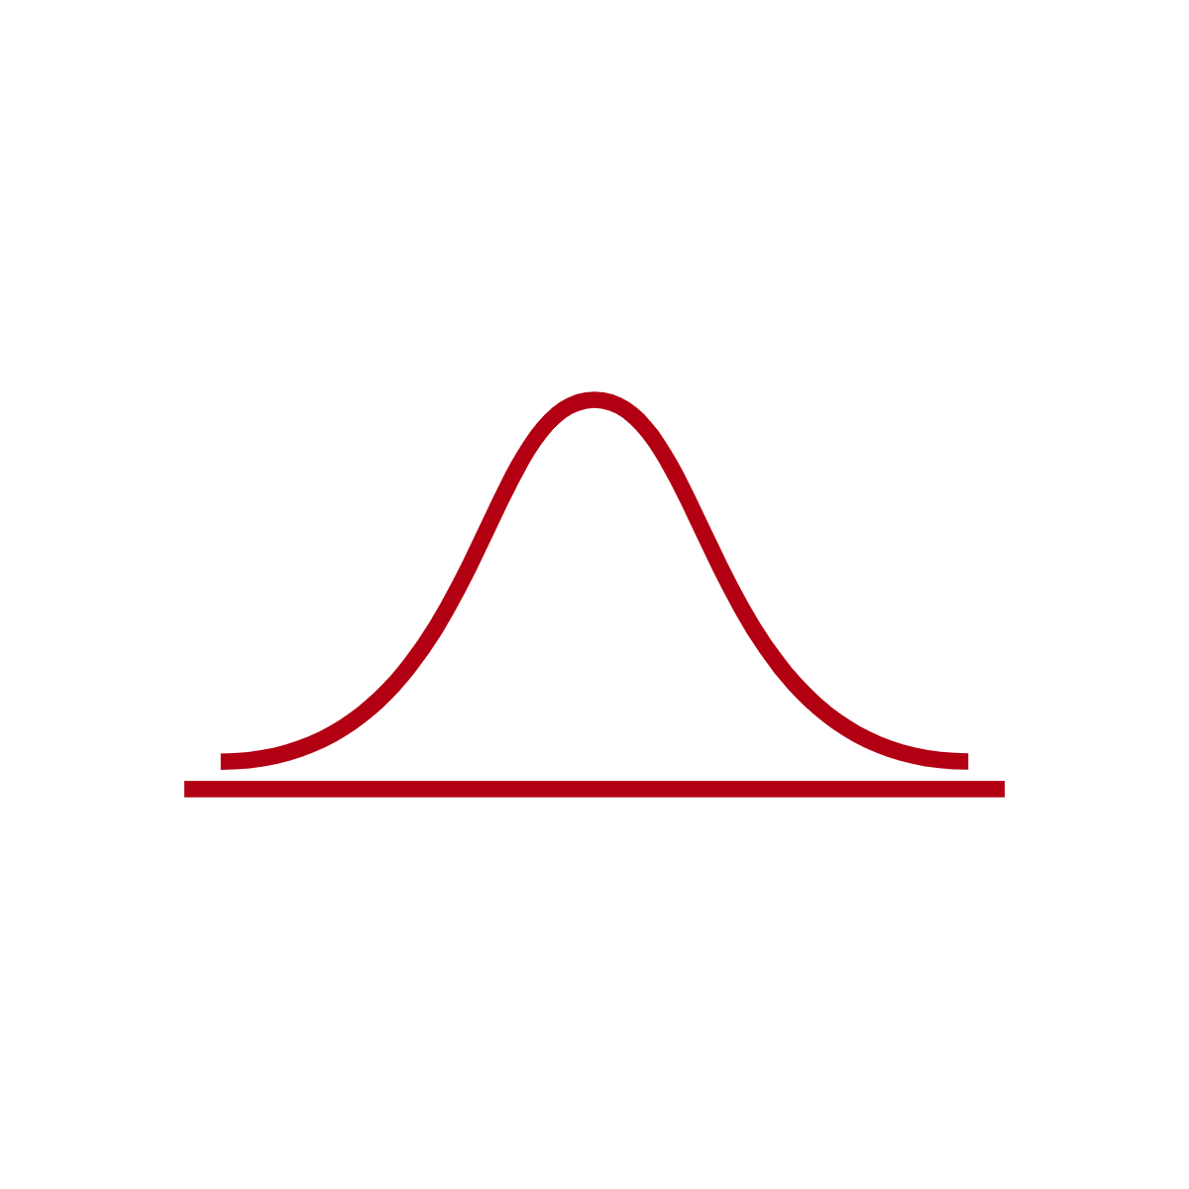
Assume P(Y|X=x) has some parametric form
μ = 1
σ = 1
μ = 2
σ = 0.5
μ = 2.5
σ = 0.75
μ = 3.5
σ = 1.5

Slide 12
Use gradient boosting to estimate the parameters as a function of x
Review gradient descent for parametric models
Understand how boosting is gradient descent in functional space with an approximated gradient
Understand how gradient boosting can be used to fit probabilistic regression models

Slide 13
Gradient descent for a parametric model: the loss surface

Slide 14
Gradient descent for a parametric model

Slide 15
Gradient descent for a parametric model: the gradient
In other words, the derivative we know how to compute from calculus happens to tell us which way to adjust the parameters
-

Slide 16
Example: ordinary linear regression

Slide 17
More generally,

Slide 18
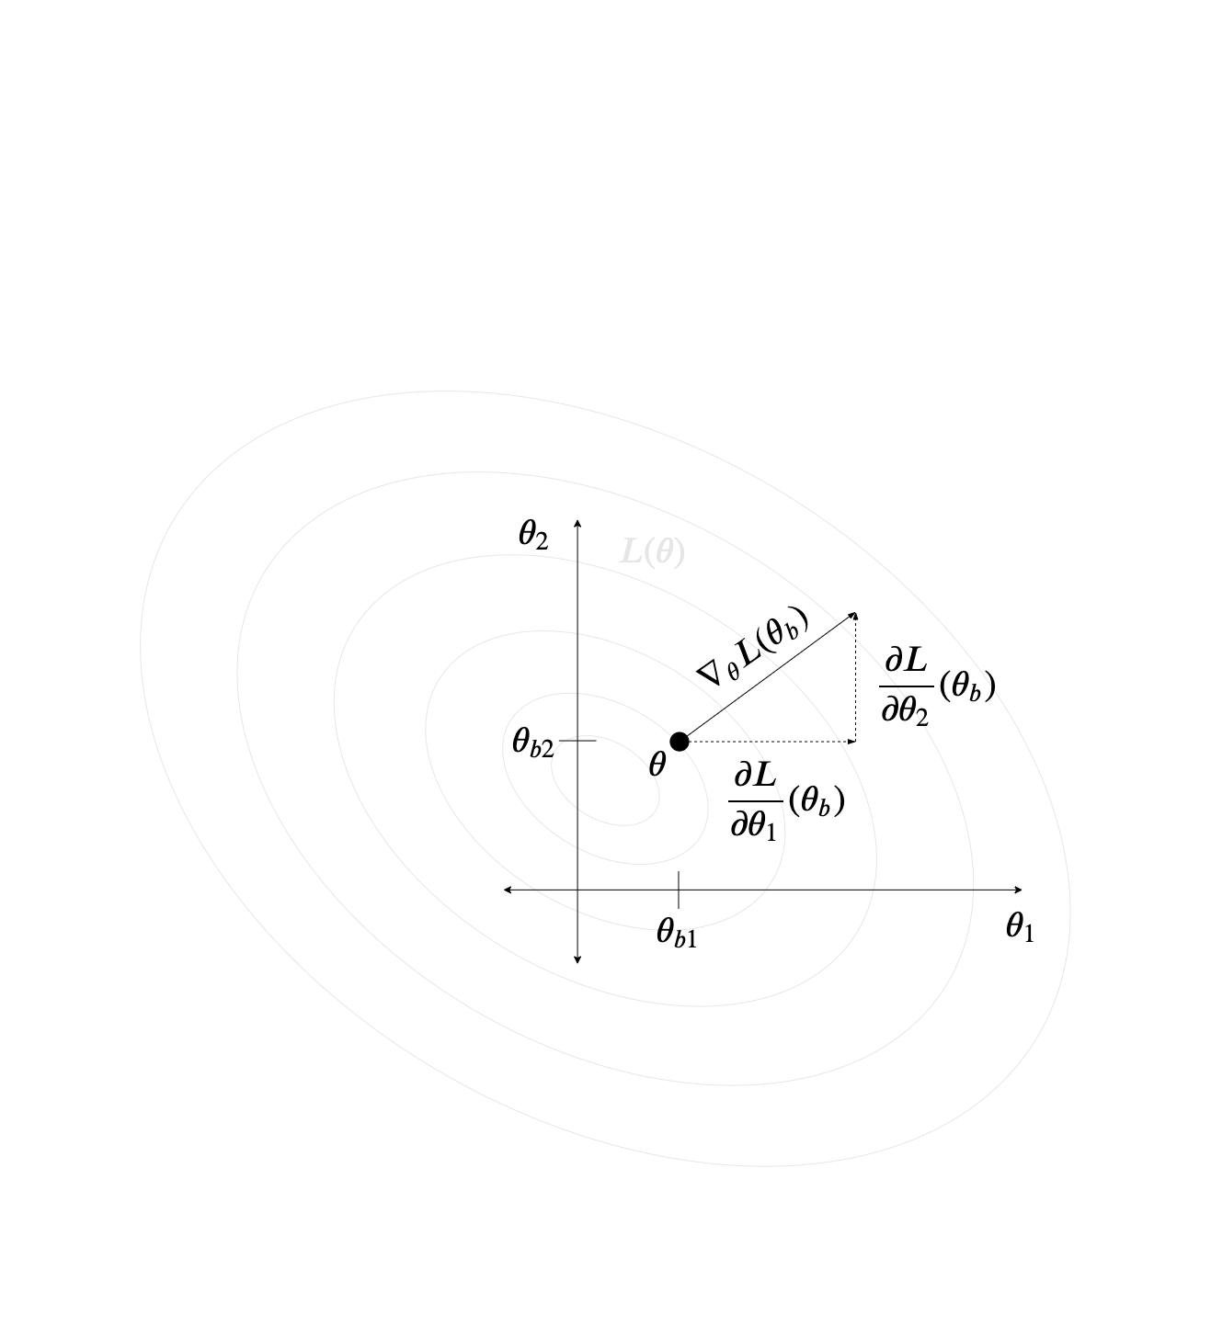
The gradient

Slide 19
Gradient descent for a parametric model

Slide 20
Assuming a parametric form is restrictive
Boosting idea: the prediction itself is the parameter

Slide 21
An infinite number of parameters (one per possible value of x)

Slide 22
The gradient is even easier to derive now. For example, with squared-error loss,

Slide 23
The gradient is even easier to derive now. For example, with squared-error loss,

Slide 24
If we start with a model θ₀(x) = 0 for all x and take B steps, the final model is

Slide 25
What happens when we try and predict at a new value of x?
We never saw y here, so we can’t compute what the gradient would be at any iteration!

Slide 26
Gaps in the gradient

Slide 27
Gaps in the gradient

Slide 28
Gaps in the gradient

Slide 29
Gaps in the gradient

Slide 30
Gaps in the gradient

Slide 31
Boosting idea: fill in the gaps with a regression model (base learner)

Slide 32
Boosting idea: fill in the gaps with a regression model (base learner)
Must do this at each step

Slide 33
Taking B steps starting at 0, our model is
To predict at a new x, sum up the predictions of each of the B regressors at that x

Slide 34
NGBoost idea: we can apply this strategy to fit probabilistic regression models

Slide 35
Example: NLL score and Normal distribution

Slide 36
Example: NLL score and Normal distribution

Slide 37
So instead of boosting one function, we need to boost as many as there are parameters
At each boosting iteration, we fit p models, one per parameter

Slide 38
At the end of this, we have, for any x, a predicted distribution of y

Slide 39
Outline of our approach
Pick a scoring rule to grade our estimate of P(Y|X=x)
Assume that P(Y|X=x) has some parametric form
Fit the parameters θ(x) as a function of x using gradient boosting
Use the natural gradient to correct the training dynamics of this approach

Slide 40
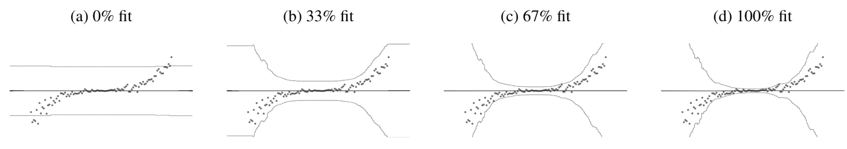
Our boosting approach gives us probabilistic prediction, but performs poorly

Slide 41
Experiment
UCI ML Repository regression benchmarks
72 training/18 validation/10 test split, repeated 20 times
algorithm configured with NLL score and Normal distribution
Evaluation is test-set NLL
Compare to homoscedastic boosting:
First fit a standard boosting model and use ŷ(x) as μ̂(x)
Estimate a global variance

Slide 42
Ideal probabilistic regression

Slide 43
Homoscedastic boosting

Slide 44
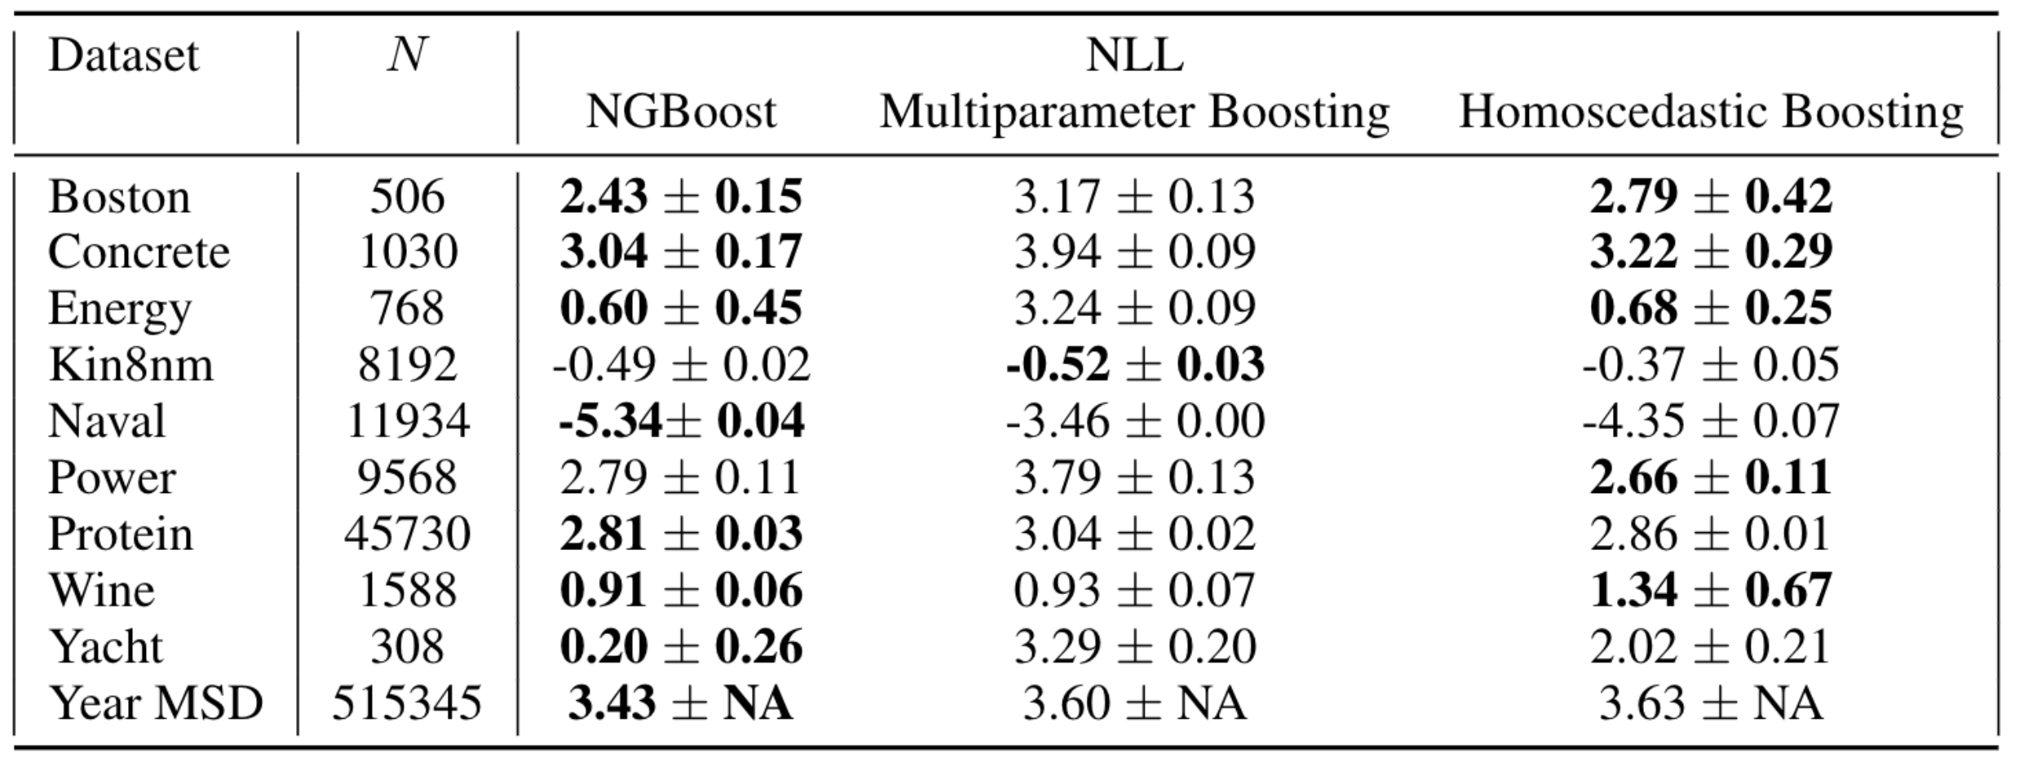
Results: multiparameter boosting approach is worse than benchmark

Slide 45
Why?
We relaxed an unrealistic assumption, so we expect performance to increase, not decrease
However, this picture suggests that the algorithm is failing to adjust the mean (in this example).
There is a better optimum, but we can’t find it

Slide 46
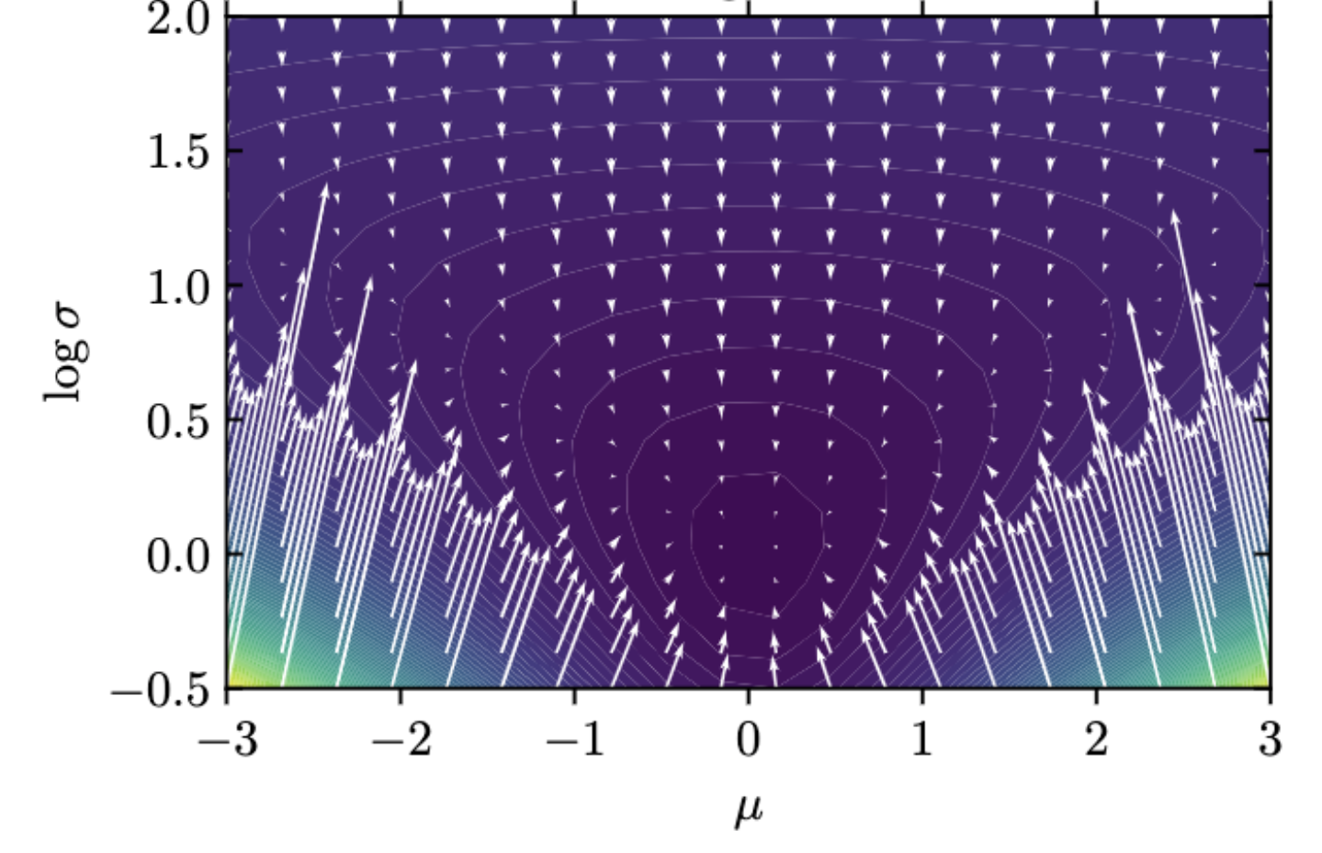
Visualizing the gradients at a point x where
Gradients with respect to the mean are tiny compared to those with respect to the variance

Slide 47
Outline of our approach
Pick a scoring rule to grade our estimate of P(Y|X=x)
Assume that P(Y|X=x) has some parametric form
Fit the parameters θ(x) as a function of x using gradient boosting
Use the natural gradient to correct the training dynamics of this approach

Slide 48
Stepping back: the space of distributions P(Y|X)
Distributions of the desired parametric form
P

Slide 49
Gradient descent in the space of distributions

Slide 50
Parametrizing the space of distributions
is just a “name” for P
Each distribution has such a name (i.e. is “identified” by its parameters)

Slide 51
Parametrizations are not unique

Slide 52
What we typically do: gradient descent in the parameter space

Slide 53
Gradient descent in the parameter space is not gradient descent in the distribution space because distances don’t correspond

Slide 54
Example: two normals

Slide 55
Example: two normals
d=2
2
1
-2
0
2

Slide 56
Example: two normals
d=2
2
d=2
1
-2
0
2

Slide 57
Gradient descent in the parameter space is not gradient descent in the distribution space because distances don’t correspond

Slide 58
Gradient descent in the parameter space is not gradient descent in the distribution space
Moreover, different parametrizations will result in different gradient steps in the distribution space

Slide 59
Idea: do gradient descent in the distribution by searching parameters in the transformed region
this is the natural gradient

Slide 60
We can conveniently compute the natural gradient by applying a transformation to the gradient
is the Riemannian metric of the space of distributions
It depends on the parametric form chosen and the score function
If the score is NLL, this is the Fisher Information

Slide 61
Why? To solve this optimization (for NLL)…
Use KL divergence as the distance in distribution space
Not arbitrary- every scoring rule induces its own divergence
Take the 2nd order Taylor expansion to see that KL divergence between distributions with parameters and is approximated by
Write the optimization in Lagrangian form, set derivative to zero, gives:

Slide 62
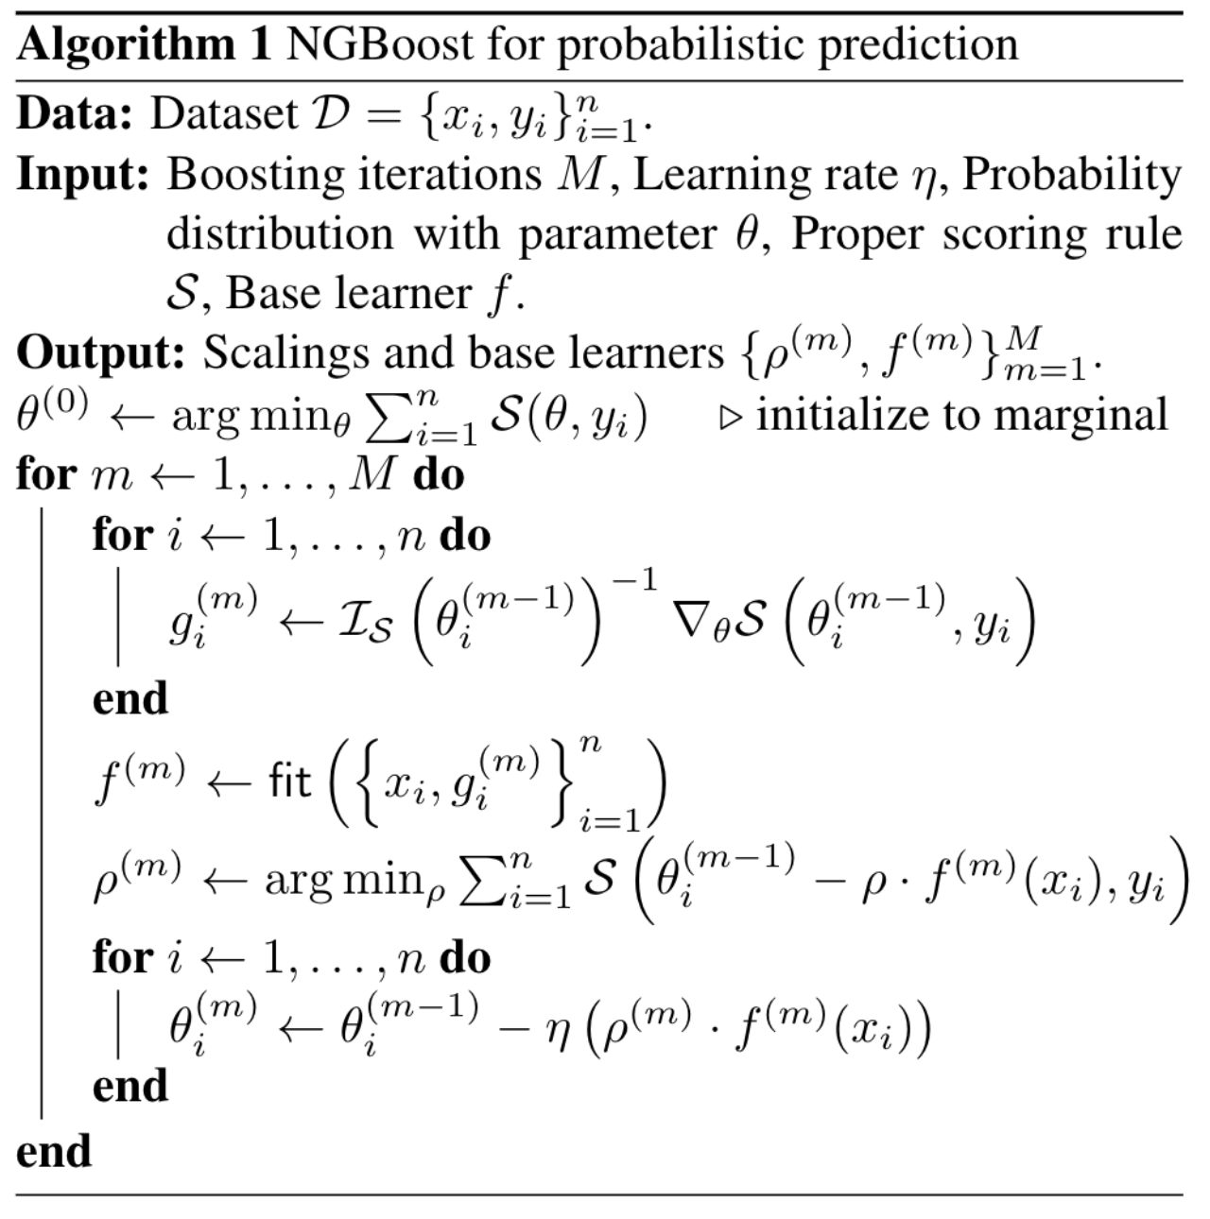
NGBoost is our multiparameter boosting approach with a natural gradient update

Slide 63
The natural gradient fixes performance

Slide 64
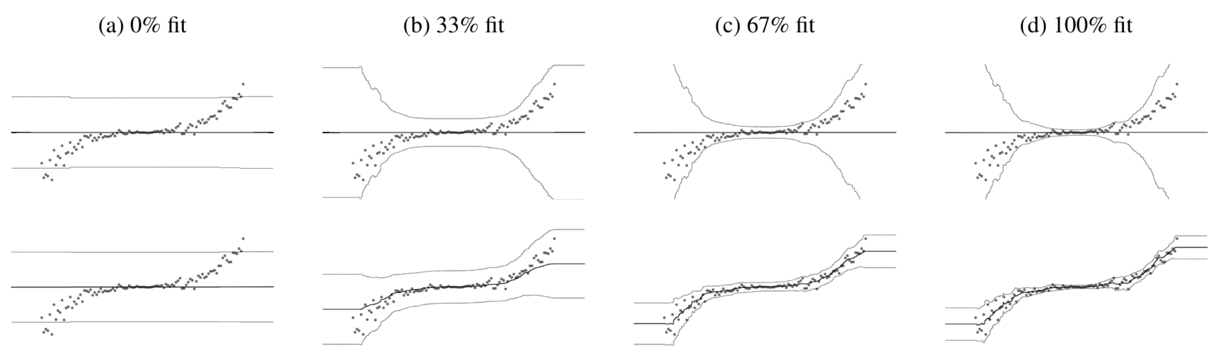
… by improving the training dynamics
Ordinary
Natural

Slide 65
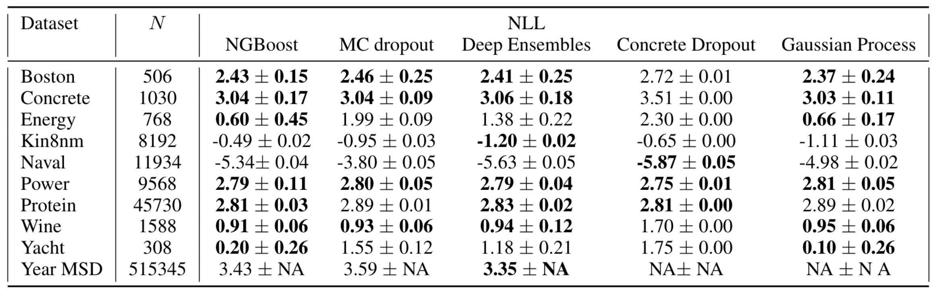
The result is equal or better performance than state-of-the art probabilistic prediction methods
(same experimental setup as previously described)

Slide 66
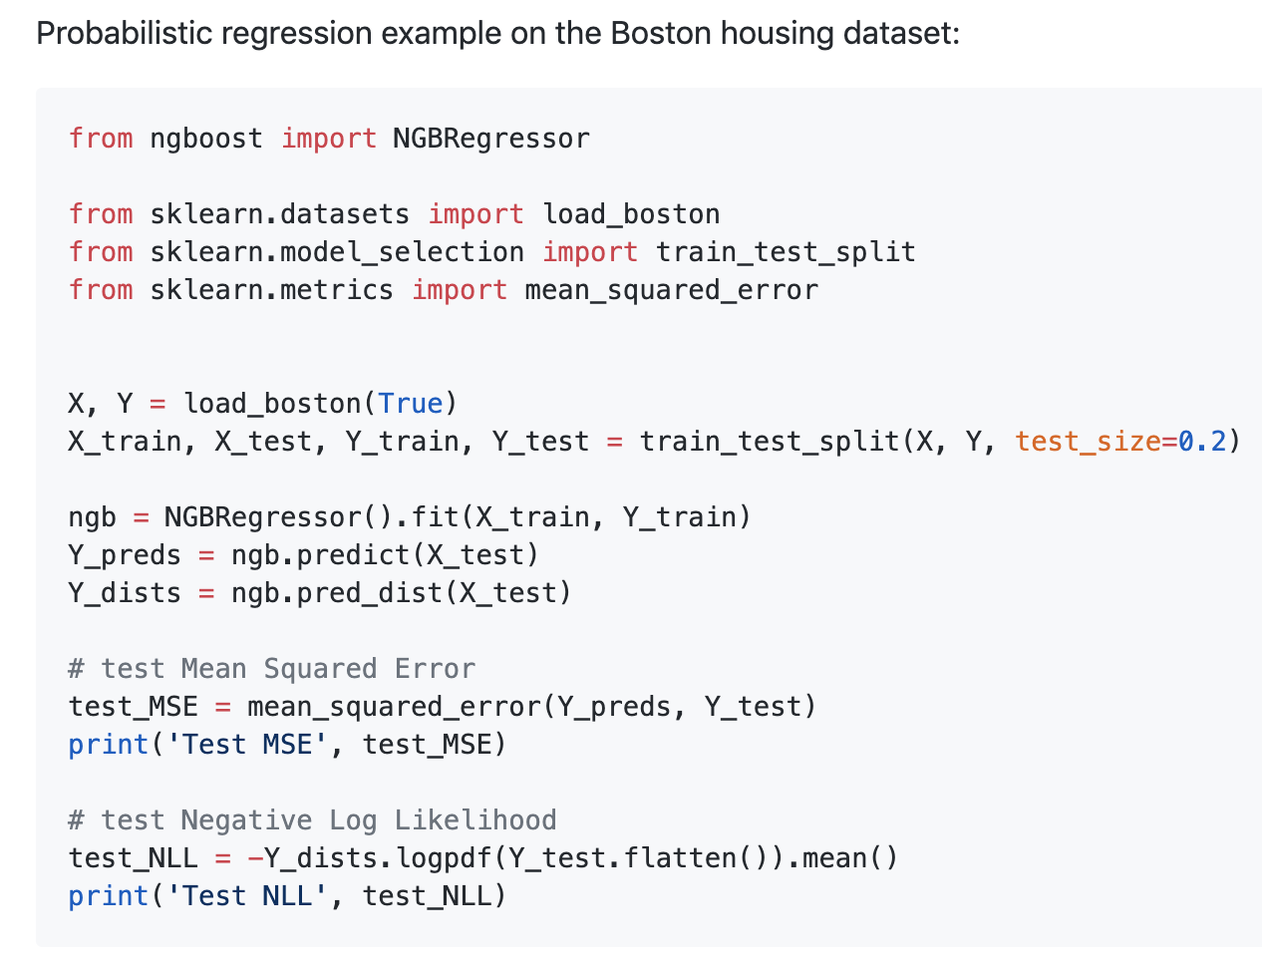
But unlike other methods, NGBoost is fast, flexible, scalable, and easy to use
No MCMC
Few restrictive assumptions
Works for regression, classification, survival, etc.
Scales like gradient boosting
Scikit-learn compatible

Slide 67
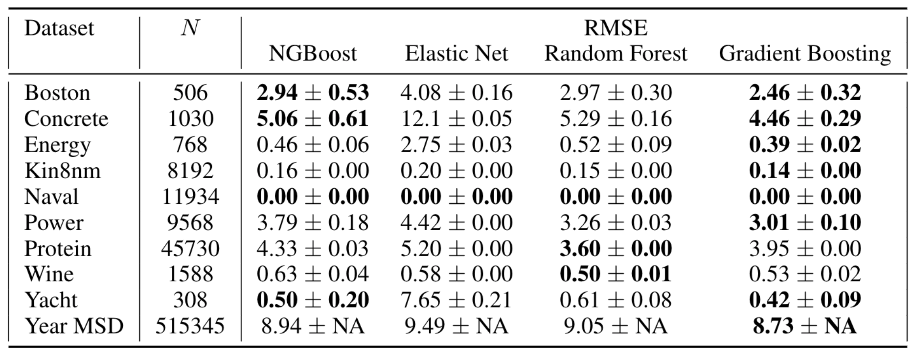
NGBoost is competitive for point prediction too, even if optimized for NLL

Slide 68
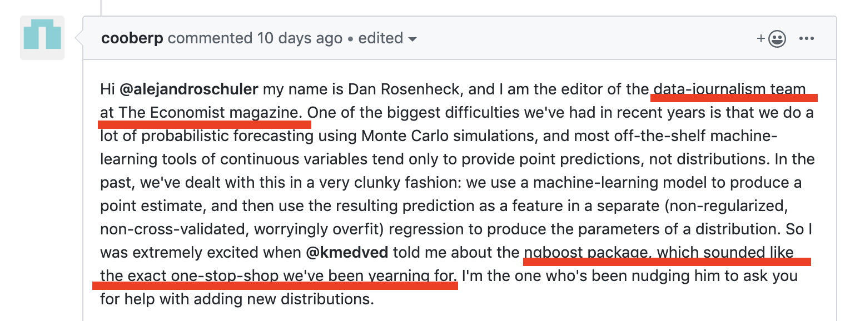
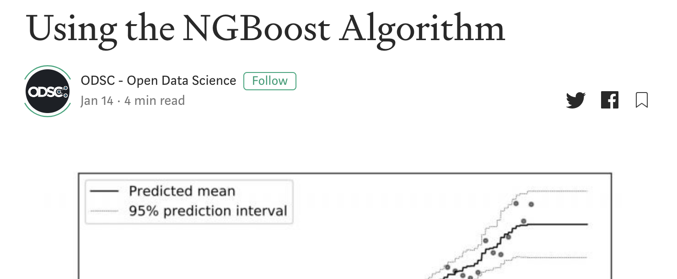
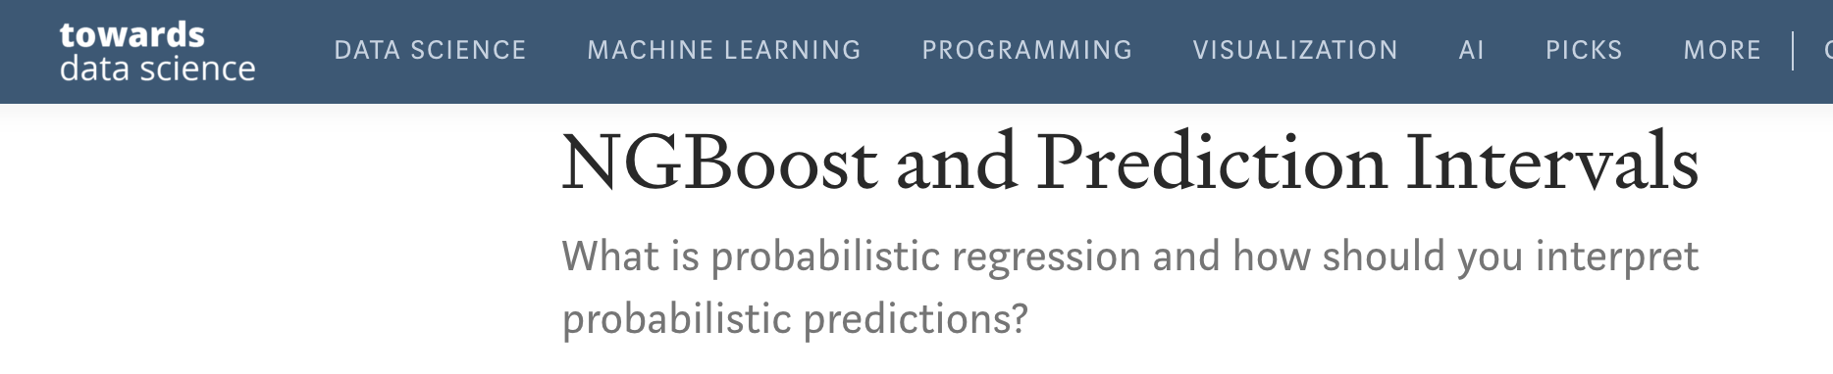
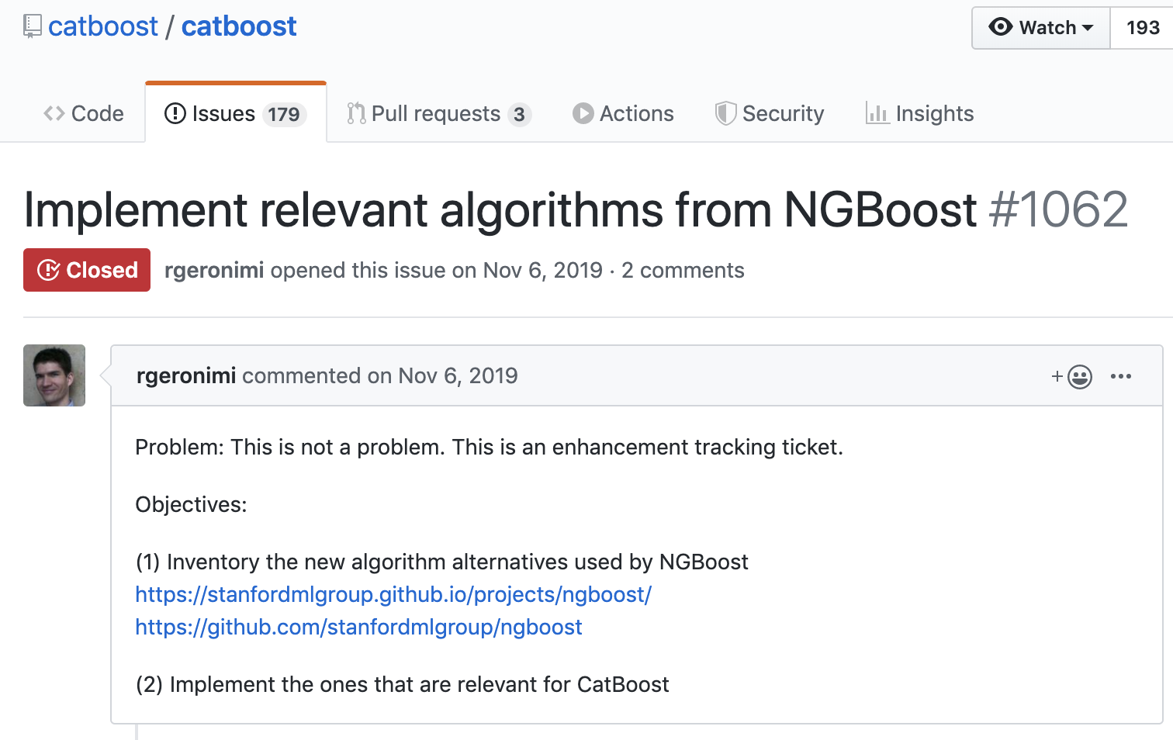
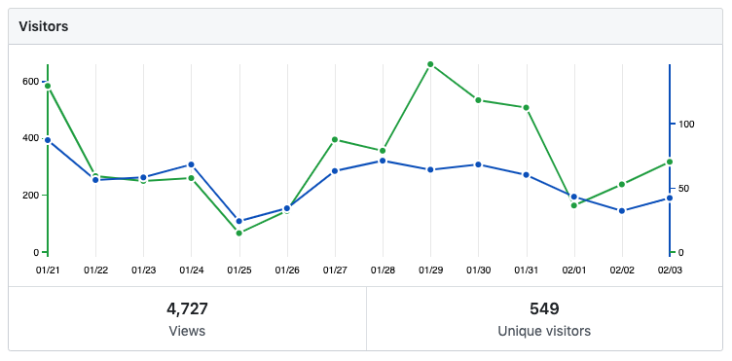
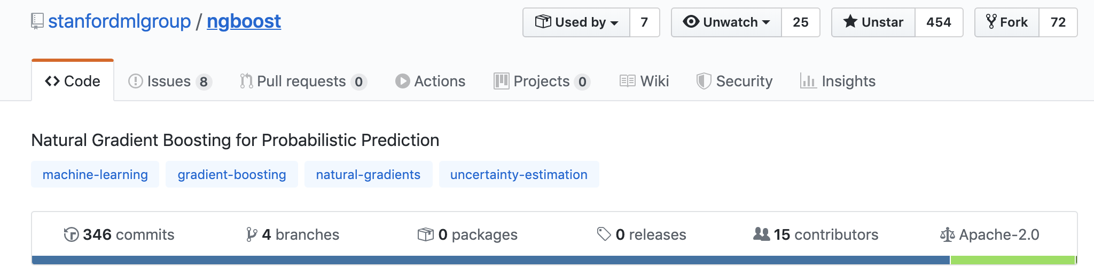
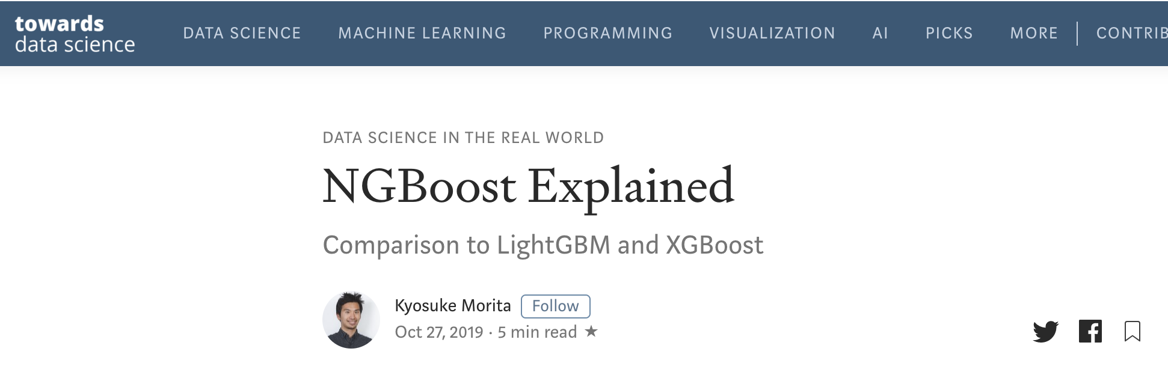
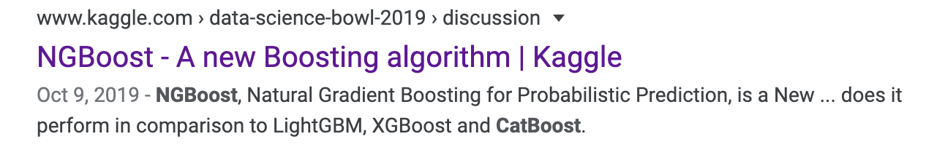
NGBoost is getting attention

Slide 69
Future work / opportunities for involvement
Demonstrate use on censored data problems (e.g. survival)
Censored likelihood or survival CRPS are both useable scores
Demonstrate use for joint-outcomes regression (e.g. ”what’s the probability that it rains >3 inches and is >15C tomorrow?”)
Assume a parametric joint form and NGBoost does the rest
Implement optimizations from other boosting libraries, etc.

Slide 70
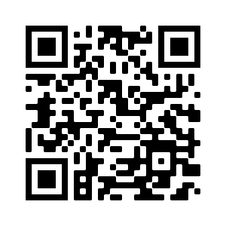

Paper
NGBoost: Natural Gradient Boosting for Probabilistic Prediction
Tony Duan*, Anand Avati*, Daisy Ding, Khanh K. Thai,
Sanjay Basu, Andrew Ng, Alejandro Schuler
Github

